Slide 1


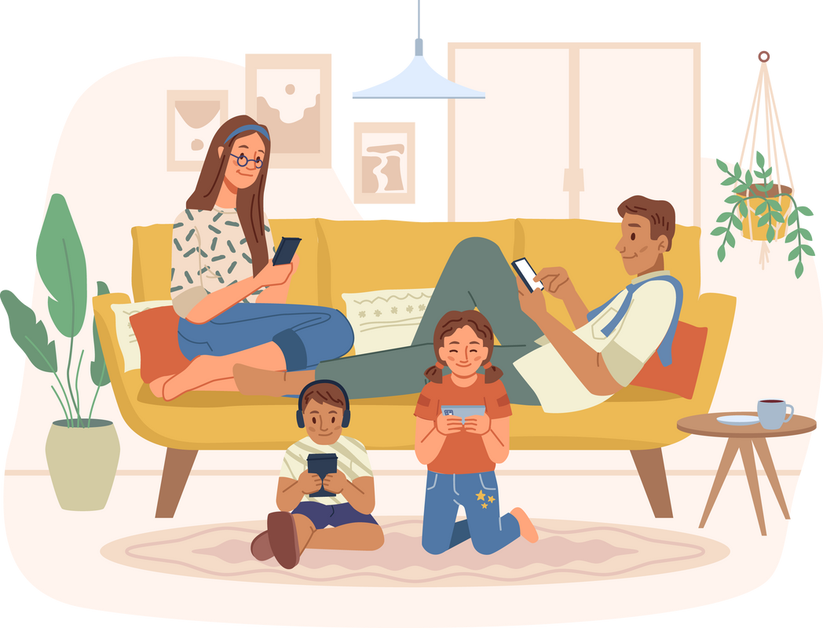

Guide to responsible mobile phone use

Slide 2

Guide to responsible mobile phone use
Contents
01
02
03
Presentation
The CAA alert
Before giving them a mobile phone
04
05
Responsibilities
Ten rules, supervision and recommendations
4.1. Types of responsibility
4.1.1. Administrative
4.1.2. Civil
4.1.3. Criminal
4.2. Educators and educational centres
4.3. Can adults control messages and content on a minor's mobile phone?
4.3.1. Before the age of 14
4.3.2. After the age of 14
4.4. Minors and networks
5.1. Children should not have private use of a mobile phone
5.2. Parental control and supervision
5.3. Be careful with data and social networks
5.4. Downloading apps
5.5. Setting times and places for use
5.6. Who they talk to
5.7. Bullying and dangers
5.8. Critical thinking and responsibility5
.9. Agreements and space to disconnect
5.10. What have you done on the Internet today?
Contents
1.

Slide 3


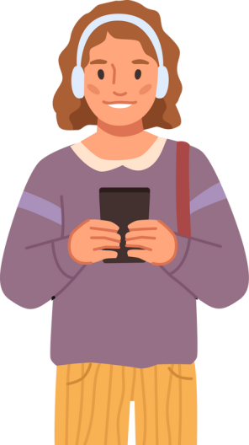

06
Myths and realities
6.1. Teenagers are digital natives and are fully familiar with new technologies and the virtual world.
6.2. No one can see the material on a device.
6.3. Technology generates broader knowledge and critical thinking.
6.4. I can delete what I do or say online.
6.5. Children's technological knowledge exceeds that of their parents and they can circumvent parental controls.
6.6. Social media cannot be controlled.
6.7. The content on social media is appropriate for boys and girls of their age.
6.8. Video games are not as risky as social media.
6.9. Mobile phones and technology connect them and help them socialise.
6.10. Teenagers need a mobile phone for safety reasons.
07
References
7.1. Some parental control systems
2.

Slide 4

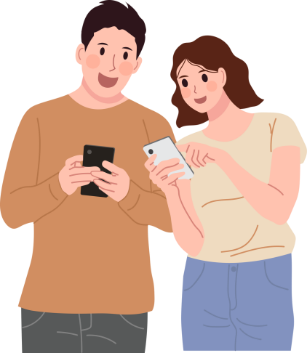

Guide to responsible mobile phone use
01
Presentation
The CAA has produced this guide for parents, teachers and guardians of minors to help them understand how to use tools and resources when giving children a device connected to the Internet. It also serves as a reminder of how ignorance or misuse of these devices can affect their development, their lives and their legal responsibilities.
This guide contains advice on digital support in general and, in particular, emphasises the proper use of mobile phones by young people.
Because it is the dominant and omnipresent device in everyone's lives and the one with which the vast majority live and access the Internet.
3.

Slide 5
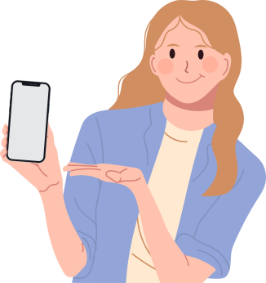


02
CAA warns
Technology affects us physically, mentally, socially and sexually at any age, from birth to the end of life, but minors are more exposed and defenceless. The data handled by this Council shows that the probability of a minor accessing inappropriate content on the Internet via a mobile phone is very high and that access to such content can be harmful to them.
After conducting our own research, we have discovered and warned of the easy access minors can have to dangerous, pornographic and violent content, which is not only inappropriate for them, but also of dubious legality and even shocking for adults.
A minor can have easy access to
Dangerous
Since 2021, the CAA has been developing measures to protect minors on the Internet.
pornographic
Our organisation has verified that a minor, with an unsupervised mobile phone, can easily access content related to pornography, crime, animal abuse or extreme violence.
violent
Contents
4.

Slide 6

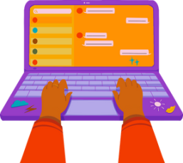




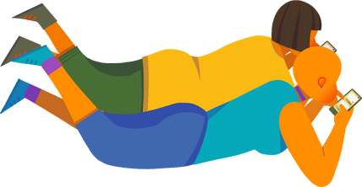
Guide to responsible mobile phone use
According to data from the BAA* of the CAA 2023:
45% of children under 18 start using the Internet around the age of 8.
20% of teenagers use it constantly.
The data tells us that::
According to other sources,
in addition:
Children access mobile phones for the first time before the age of 11 on average.
30% have received passive sexting.
Only 24% have rules set by their parents regarding their use.
Most teenagers admit to taking their mobile phones to their bedrooms at night.
Some children in Spain are now accessing online pornography for the first time at the age of 8.
Future
Plan
In Spain, one in four boys begins consuming online pornography before the age of 13, and by the age of 14, consumption of this content is widespread.
5.

Slide 7

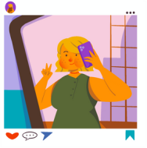



03
Before giving them a mobile phone
There is no agreement on the ideal minimum age for a child to start using a mobile phone.
It is a decision that each family must make for themselves.
Families should assess their children's maturity and family needs before giving them a mobile phone, as well as the safety issues that often underlie this decision and whether delaying the purchase of this device could result in children being excluded from obtaining information that is relevant to them.
However, based on the reality reflected in the statistics and scientific studies consulted, it seems appropriate to offer advice here on how these devices can affect minors and guide their proper use together with parents, teachers, guardians and educators:
Tips
Consider the child's age, personality and independence..
Ask yourself why they want or need it. What are their reasons for asking for it and what do adults consider important?
Be aware of each child's behaviour, as there is a risk of abusive use of technology that isolates the child and leads to them socialising via their mobile phone.
Assess the real possibilities of accompanying minors in this process.
6.

Slide 8
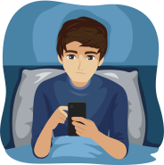


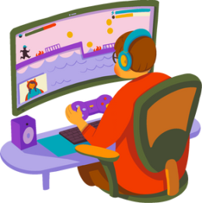

Guide to responsible mobile phone use
How can devices affect them if used excessively?
1
Sleep disturbance.
Alteración del sueño
Risk of obesity due to reduced physical activity if too much time is spent in front of screens.
2
3
Eye strain, myopia, etc.
Distraction
4
Reduced attention span and possible neurodevelopmental and learning disorders.
5
Anxiety and difficulty setting boundaries and accepting those set by adults.
6
Impulsiveness and impatience, especially in adolescence.
Social isolation
7
Social isolation.
8
Risky behaviour due to access to inappropriate and harmful content..
7.

Slide 9

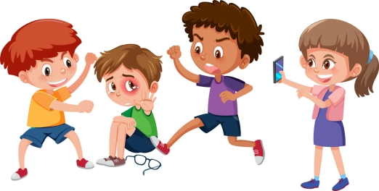

04
Responsibilities
Parents and guardians are responsible for the education and protection of the minors in their care and for the actions that minors commit.
Constant mobile phone use can lead minors to commit illegal and even criminal acts without being aware of the consequences.
For example:
Disseminating sensitive content or information about other people without their consent can be a crime with different types of responsibilities.
Bullying, discriminating against or mocking others on social media or other Internet services may violate the rights of the people affected and be against the law.
Minors are not criminally responsible until the age of 14 (Art. 3 of Organic Law 5/2000).
Before that age, the adults responsible for their guardianship are liable and remain financially, administratively and civilly responsible for them until they reach the age of majority for any material and moral damages caused.
8.

Slide 10


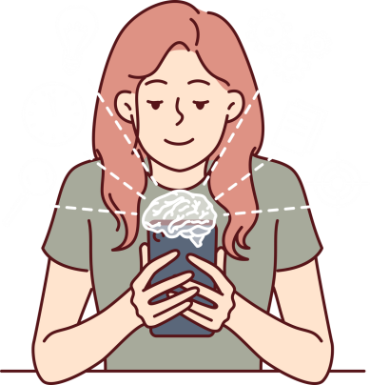

Guide to responsible mobile phone use
This is true for both real material and material generated by artificial intelligence, a technology that allows the creation of texts, images, and videos that appear to be real but are not.
Estas creaciones falsas (fakes) tienen una apariencia tan realista que pueden producir los mismos daños que una imagen o hecho real.
It is important to know that it is also a crime to use these fake creations to intimidate or to show a supposed intimate situation involving people, whether minors or not.
Young people and adults should be aware of the offences and crimes that can result from the use of these artificial intelligence tools, which are already regulated by new European legislation.
Tools such as Chat GPT and many other applications used to generate virtual content are well known.
9.

Slide 11


4.1
Types of liability
4.1.1
Administrative
For example, obtaining and publishing sensitive information (images, audio, videos or information of a sexual or violent nature) without consent that allows a person to be identified.
This may result in financial penalties for those who have published or contributed to the dissemination of such information. Parents or guardians are jointly and severally liable for this.
4.1.2
Civil
Material and moral damages caused to third parties by minors as a result of the conduct described (whether criminal or not) entail civil liability, for which parents or guardians are responsible.
4.1.3
Criminal
Classified offences
Bullying
If minors are over 14 years of age, they are also liable for crimes defined in the Criminal Code, such as harassment, threats or the dissemination or forwarding of images that seriously undermine a person's privacy, even if they were obtained with their permission. Examples of such crimes include sexting, cyberstalking and cyberbullying.
Threats
Dissemination of images
10.

Slide 12




Guide to responsible mobile phone use
4.2
Educators and educational centres
The aforementioned Organic Law 5/2000 obliges the education system to guarantee the full integration of students into digital society and the learning of safe use that respects human dignity and constitutional values.
A block of subjects on digital competence must be included, as well as on risk situations arising from the inappropriate use of ICT, with special attention to situations of online violence.
With regard to the protection of minors' data on the Internet, the same regulation indicates that educational centres and any natural or legal persons carrying out activities in which minors participate shall guarantee the protection of these rights.
In addition, Organic Law 8/2021 on comprehensive protection of children and adolescents against violence establishes that all educational centres where minors are enrolled must have a coordinator for student welfare and protection.
11.

Slide 13


The duties of the student welfare and protection coordinator include:
Promoting immediate communication to data protection agencies of situations that may involve the unlawful processing of personal data of minors.
As the proliferation of mobile phones encourages the dissemination of personal data through social networks and it is common for the recording and publication of sexual or violent content to be used in cases of harassment, including in schools, the educational centre can report the publication of such content on the Internet through the coordinator.
4.3
Can adults control messages and content on a minor's mobile phone?
4.3.1 Under 14
In this case, some experts point out that control is not only not wrong, but necessary. We must closely monitor what our sons and daughters do with their mobile phones or computers.
12.

Slide 14
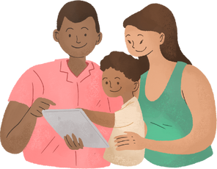












Guide to responsible mobile phone use
In fact, platforms should require permission from guardians
There are lots of parental control apps available to exercise this supervision.
It is advisable for each family to agree onconditions for mobile phone use
4.3.2 After 14
From this age onwards, children do not have to ask permission to access any app or social network and can be independent users. If a parent is certain that their child is at risk, they can monitor their mobile phone, assuming responsibility for the protection of the minor.
4.4
Minors and networks
As mentioned above, the law sets the age of consent at 14 for minors to access social networks independently, but most networks and platforms set the minimum age at ‘13 or over 13’, such as Instagram, Tiktok, Facebook, X (formerly Twitter).
Estas disposiciones no deben ser una excusa para relajar la vigilancia del comportamiento digital de los menores.
13.

Slide 15






05
Ten rules, supervision
and recommendations
5.1
CHILDREN SHOULD NOT HAVE PRIVATE USE OF MOBILE PHONES
When giving a mobile phone to a minor, it should be on the condition that their carers are responsible for the device and therefore have control over its contents and all passwords.
5.2
PARENTAL CONTROL AND SUPERVISION
Mobile phones must have a parental control system so that no mistake, curiosity or accidental search leads minors to inappropriate and dangerous places, although these systems and the device itself must be regularly supervised by adults.
Depending on the maturity of the minors, restrictions on time and content will be agreed with them.
5.3
BE CAREFUL WITH DATA AND SOCIAL MEDIA
Parents and guardians should be aware of the data that minors enter on social media and apps. Even if there is agreement on the use of some of them, it is important to insist that they ask their elders what data they can share, so that it is possible to know if they are signing up for a service that requires personal data or payments.
14.

Slide 16




Guide to responsible mobile phone use
5.4
DOWNLOADING APPLICATIONS
Those responsible for minors should be particularly vigilant about downloading or using applications that do not require age verification and that allow for easily illicit uses, such as those explicitly designed to generate virtual nudes using artificial intelligence.
5.5
SET TIMES AND PLACES OF USE
It is necessary to clearly set times of use, as well as the place in the house where mobile phones will be left at the end of the authorised time; furthermore, devices should not be allowed to be charged in minors' bedrooms, nor should they be allowed to go to bed with them.
5.6
It is advisable to be well informed about the people your children talk to or interact with on social media, who they play with online, and to monitor their social media and video game chats and who they follow. Children should not add anyone they do not know in real life to their social media accounts.
They should never share information about where they live, which school they attend,
or where they do extracurricular activities.
WHO THEY TALK TO
15.

Slide 17
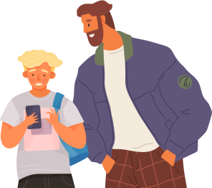



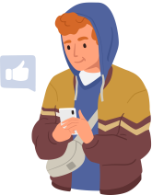
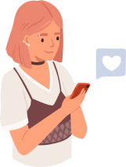
5.7
Families and children can learn together about the risks they face when using mobile phones, such as sexting (sharing sexually suggestive images of oneself), grooming (adults posing as minors to gain access to them), or addiction. Adults should make it clear to them that they should not share intimate images, request them, or forward them if they receive them.
BULLYING AND DANGERS
5.8
CRITICAL THINKING AND RESPONSIBILITY
There are actions on the Internet that have consequences. Parents should make this clear to minors. They should encourage their responsibility and ability to reason before spreading sensitive data or images of other people, using mobile phones to mock others or spreading false information.
Parents are responsible for the actions of their minor children
16.

Slide 18







Guide to responsible mobile phone use
5.9
AGREEMENTS AND SPACE FOR DISCONNECTION
It is necessary to make them understand that mobile-free moments are required to share with family or to have positive and different experiences with friends. Also because they need to concentrate on their studies. It is advisable to establish family agreements to avoid problematic and addictive use of technology.
5.10
It is advisable to take an interest in your child's ‘digital day’. Observe their behaviour and whether they are maintaining their physical and mental well-being. Take the opportunity to find out if they need to talk about issues that may cause them embarrassment. It is a good idea to show curiosity about how their social networks work or how they play their video games. You should also show closeness and accessibility if you think something is going on.
WHAT HAVE YOU DONE ON THE INTERNET TODAY?
If you need help or want
to report inappropriate behaviour.
If you need help, you can turn to professionals in the audiovisual sector.
CALL 017
The Audiovisual Council of Andalusia, as a public entity for the protection of minors.
Priority Channel of the Spanish Data Protection Agency (AEPD)
www.consejoaudiovisualdeandalucia.es
www.aepd.es
17.

Slide 19





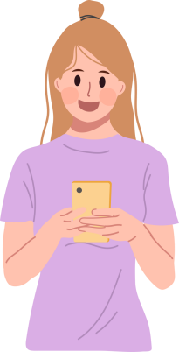



06
Myths and realities
MYTH
vs.
REALITY
6.1
“Teenagers are digital natives and are very familiar with new technologies and the virtual world.”
Just because they were born in the digital age does not mean that they know how to use devices correctly, are aware of their educational potential, or know what risks they are exposed to.
6.2
Through error or criminal activity by third parties, it can fall into the hands of others who use it to cause harm, such as when accessing highly vulnerable Wi-Fi networks in public places like shopping centres or airports.
“No one can see the material on a device”
18.

Slide 20











Guide to responsible mobile phone use
MYTH
vs.
REALITY
Young people mainly use the Internet for leisure and entertainment. They consume content in a brief and superficial format. This makes them susceptible to being influenced by the masses, by popularity and by companies that often seek their own interests.
6.3
“Technology generates broader knowledge and critical thinking.”
6.4
What is published online is beyond our control and can be used by others before we request its removal, and even after, as it may have been copied and forwarded by someone else.
“What I do or say online can be deleted”
6.5
“Children's technological knowledge exceeds that of their parents and they can circumvent parental controls”
Most parental control resources have passwords, PINs or other methods that parents can use to prevent inexperienced users from modifying them.
19.

Slide 21








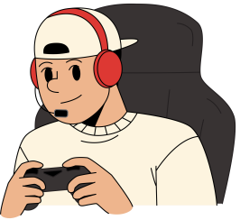

MYTH
vs.
REALITY
By being close to them, talking to them and listening to them, yes, just as you would know about their friends or activities in the real world.
6.6
“Social media cannot be controlled.”
On social media, teenagers do not usually control the age of users, and the content they have access to is very diverse, ranging from enriching and creative to criminal or harmful (violence, pornography, drugs, self-harm, etc.).
6.7
“The content on social media is typical of boys and girls their age.”
6.8
“Video games are not as risky as social media”
Private communications in most online video games are not monitored and allow for the free exchange of all kinds of content.
20.

Slide 22
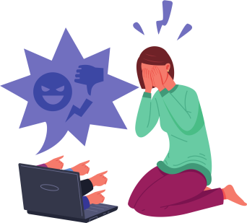





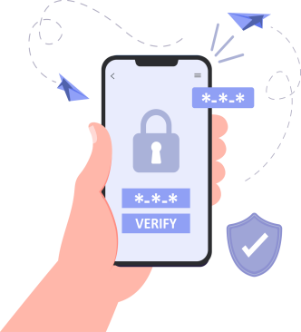


Guide to responsible mobile phone use
Cyberbullying can also occur through video game chat rooms and in forums and virtual communities, not just on social media. Video games are also used to divert minors to other harmful content.
MYTH
vs.
REALITY
6.9
“Mobile phones and technology connect them and help them socialise”
Experts argue that screens interfere with the development of children's and teenagers' skills and could limit their ability to cope with a virtual environment, where they are exposed to many risks.
6.10
If adults give them one for this reason, it does not need to be a mobile phone with an Internet connection, but one that allows calls.
“Teenagers need a mobile phone for safety reasons.”
21.

Slide 23

07
References
The following data, content, and resources were consulted and used as references in the preparation of this document:
Access to pornography begins at age 8 and becomes widespread at age 14: https://joveneseinclusion.org/2019/06/10/el-acceso-a-pornografia-se-adelanta-a-los-8-anos-y-segeneraliza-a-los-14/
Spanish Paediatrics Association. (2023, 20 October). Cambia el Plan, a campaign by the AEP and the AEPD to reduce the risks of screen misuse in childhood and adolescence: https://www.aeped.es/noticias/cambia-plan-una-campana-aep-y-aepd reducir-los-riesgos-mal-uso-laspantallas-en-infancia-y
Spanish Paediatric Association. Family Digital Plan of the Spanish Paediatric Association: https://plandigitalfamiliar.aeped.es/plandigitalfamiliar.php
Villar, Francisco. (2023, 22 October). Mobile phones should be banned until the age of 16: https://elpais.com/ideas/2023-10-22/hay-que-prohibir-los-moviles-hasta-los-16-anos.html
Spanish Data Protection Agency (AEPD). The Agency and the Spanish Paediatrics Association launch “Cambia el Plan”, a campaign to reduce the risks of screen misuse on the health of children and adolescents: https://www.aepd.es/prensa-y-comunicacion/notas-de-prensa/la-agencia-y-la-asociacion-espanola-de-pediatria-lanzan
22.

Slide 24



Guide to responsible mobile phone use
Spanish Data Protection Agency (AEPD). A MOBILE PHONE IS MORE THAN JUST A MOBILE PHONE. Help your children to use it responsibly: https://www.aepd.es/mas-que-un-movil.
ANAR Foundation. ANAR contract for the proper use of mobile phones: https://www.anar.org/wp-content/uploads/2021/12/Contrato-ANAR-uso-mo%CC%81vil.pdfhttps://www.aepd.es/documento/la-guia-que-no-viene-con-el movil.pdf
National Cybersecurity Institute. Incibe: https://www.incibe.es/menores/familias
National Cybersecurity Institute. Incibe. Family agreements for the proper use of devices: https://www.incibe.es/menores/familias/pactos-familiares-para-el-buen uso-de-dispositivos
Andalucía Vuela. Guide to choosing the right tech gifts for children: https://andaluciavuela.es/regalos-tecnologicos/
Andalucía Vuela. Set up your electronic device with a child profile: https://andaluciavuela.es/articulos/prepara-su-dispositivo-electronico-con-un-perfil-infantil/
Community of Madrid. Guide for Parents on New Technologies: https://www.comunidad.madrid/sites/default/files/doc/juventud/cuidateguia_padres_nuevas_tecnologias.pdf
Council of the EU. (2023, 9 December). Artificial Intelligence Regulation: Council and Parliament reach agreement on world's first rules on artificial intelligence: https://europa.eu/!JCKQ6p
Organic Law 10/1995, of 23 November, on the Criminal Code. Official State Gazette no. 281, of 24/11/1995: https://www.boe.es/buscar/act.php?id=BOE-A-1995-25444
23.

Slide 25


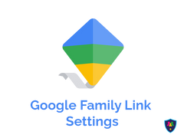




Organic Law 3/2018, of 5 December, on the Protection of Personal Data and Guarantee of Digital Rights. Official State Gazette no. 294, of 06/12/2018: https://www.boe.es/buscar/act.php?id=BOE-A-2018-16673
Legasa, Marta. (2019, 8 August). Teenagers on social media: how far can and should we spy on our children?: https://www.uppers.es/ciencia-y-tecnologia/redes-sociales/redes-sociales-hijos-adeolescentescontrolar espiar_18_2795895029.html
Pantallas amigas. (2022, 28 September). Minors and social media: what is the minimum age for each one? https://www.pantallasamigas.net/menores-redes-sociales-edad-minima-datos-personales/
7.1
Some parental control systems
‘Andalucía vuela’ proposes the following for Android and iOS:
A Gmail email account is required.
The aim of this app is to monitor the activity of minors on social media. By downloading the app and entering the login details for the various social media platforms on which they have accounts, you can select the notifications you want to receive: messages sent, photos posted, etc. It offers a free one-month trial. After this period, the monthly cost is 8€.
When you download the app, you will need to link it to that account. All restrictions set for that account will be available on the devices linked to This way, when you download it, you will have to link the app to that account. All restrictions set for this account will be available on the devices linked to it. It allows you to: block Internet searches, know how much time children spend using an app, track the device to know where it is at all times, or block the download of certain applications. No cost.
24.

Slide 26








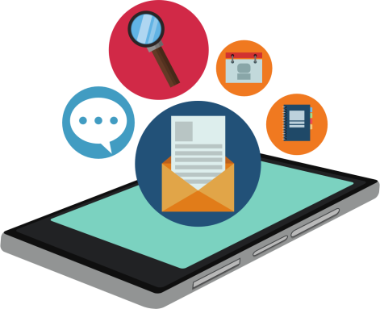
Guide to responsible mobile phone use
It offers many possibilities, such as: viewing images received and sent on children's mobile phones; viewing and reading messages received (even if they have been deleted); receiving notifications for every action your children take on the Internet; accessing their location in real time; and monitoring calls and Internet searches. It is a paid app with different rates depending on your needs, although you can try it for free.
It allows parents to see the websites their children visit, as well as the content they download to their mobile phone or computer. It also gives you the option to block access to specific sites and sends a warning every time an attempt is made to access previously restricted content. It costs 39.99€ per year.
Like Google Family Link, this app allows you to limit the time children spend on their mobile phone or tablet, as well as block apps and games. Another feature is the ability to view their chat and social media conversations and read their messages. It also has a geolocator. There is a free trial version, and after that, you can purchase a premium plan starting at 3.58€ per month.
25.

Slide 27





Guide to responsible mobile phone use
Follow us on :
www.consejoaudiovisualdeandalucia.es

Slide 28



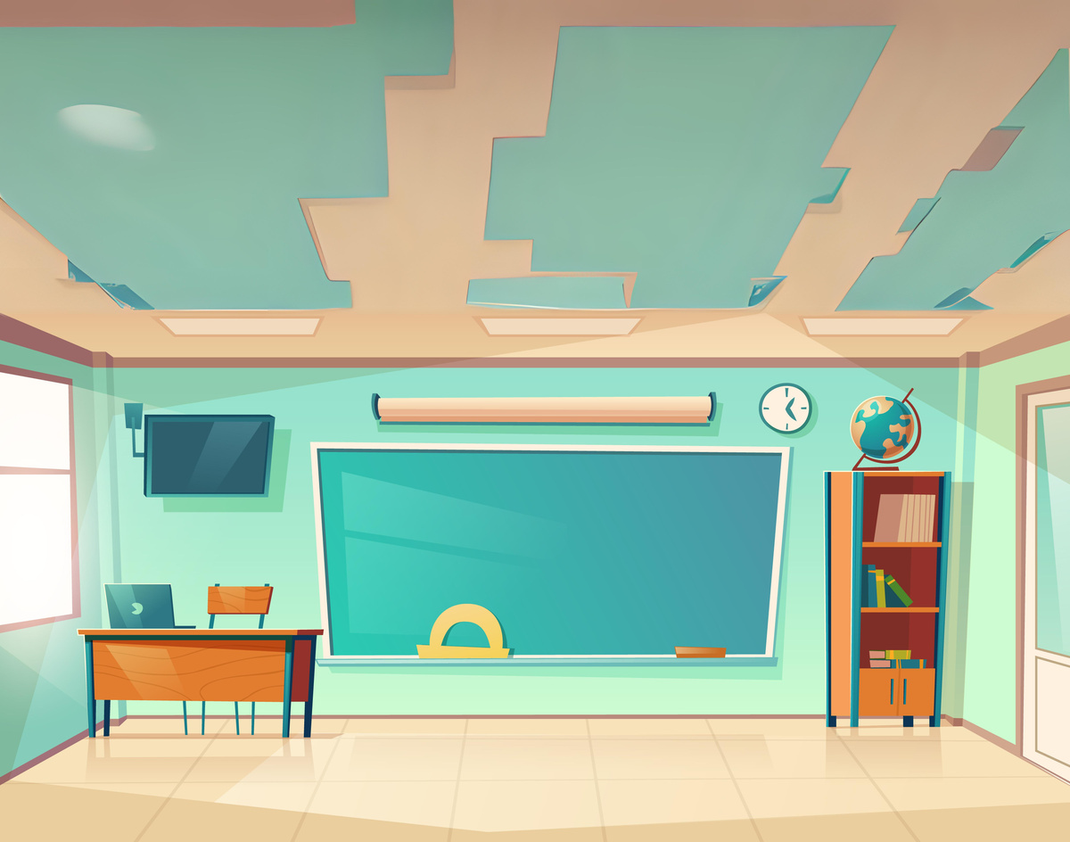







GUIDE FOR PARENTS, TEACHERS AND PEOPLE RESPONSIBLE FOR MINORS
Follow us on:
www.consejoaudiovisualdeandalucia.es

